Slide 1







Can Technical Analysis Help to Predict Future Gold Price?
Created by Anvar Akhunjanov
11849406

Slide 2
Table of Contents of Bachelor Thesis:
Abstract
1. Introduction
1.1. Background of the Study
1.2. Aim
1.3. Limitations
1.4. Thesis Structure
2. Theoretical Framework
2.1.1. Efficient Market Hypothesis
2.1.2. Technical Analysis described
2.1.3. Technical vs. Fundamental Forecasting
2.1.4. Diversification of Technical Analysis Indicatots
2.1.5. Bullish and Bearish Market, Momentum
2.2. Support and Resistance lines
2.3. Moving Average
2.3.1. SMA
2.3.2. WMA
2.3.3. EMA
.
3. Research Methods
3.1. Variables
3.2. Data
3.3. Methodology
4. Results
4.1. Empirical Findings
4.2. Comparison
5. Conclusion
6. References

Slide 3
INTRODUCTION
The vast majority of fund managers use technical analysis (Menkhoff 2010)
The introduction of new capital requirements for banks has enhanced demand for liquid assets (Lucey and Li 2015)
Precious metal commodities may be seen as safe destinations for funds during periods of stock high market volatility. (Hiller, Draper, and Faff 2006)

Slide 4
Efficient Market Hypothesis (Fama 1970)
Price of Gold
Macroeconomic Data
Geopolitical Events
Currency Movements
Interest Rate
Central Bank Policies
Market Sentiment

Slide 5



Technical analysis and its core premisses
01
MARKET ACTIONS DISCOUNT EVERYTHING
02
PRICE MOVES IN TREND
03
HISTORY REPEATS ITSELT

Slide 6
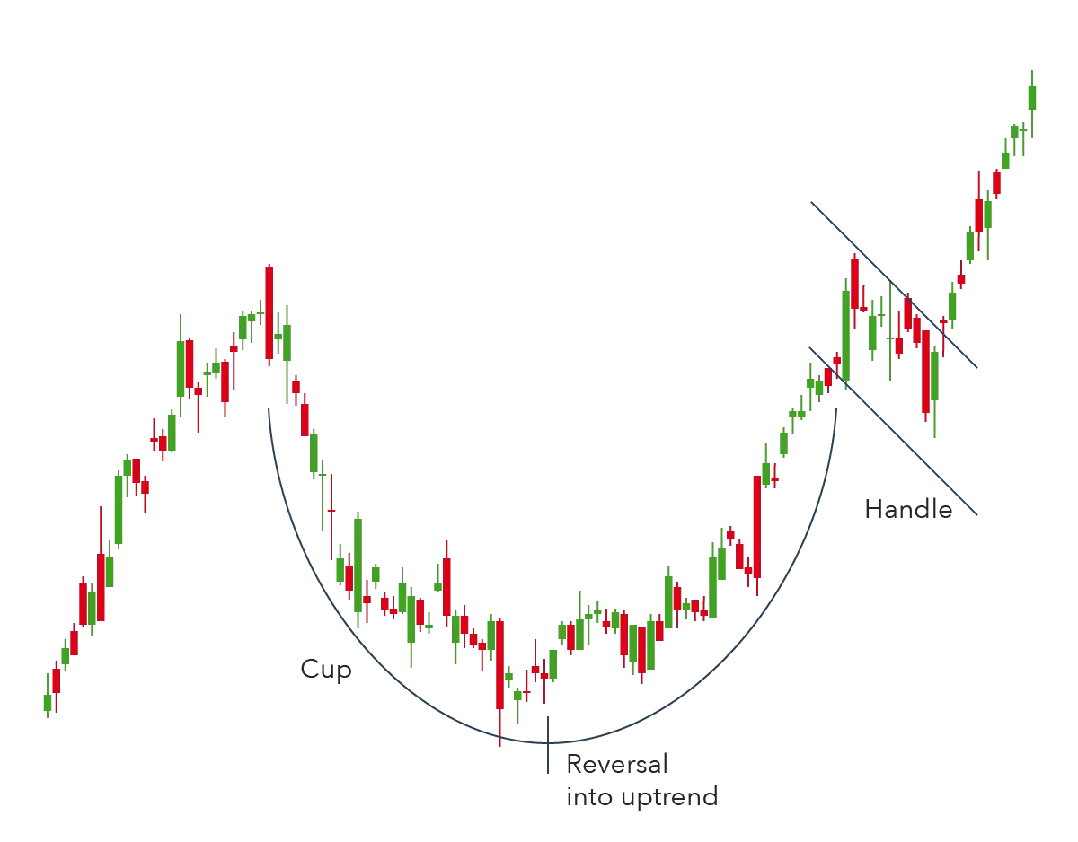



Technical vs. Fundamental Forecasting
Fundamentalist asks why, what the reason was
Technician ask what will happen next
t

Slide 7
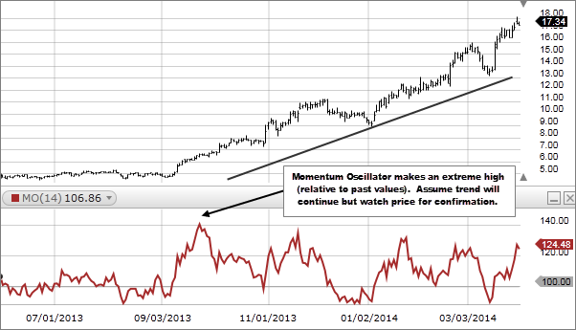
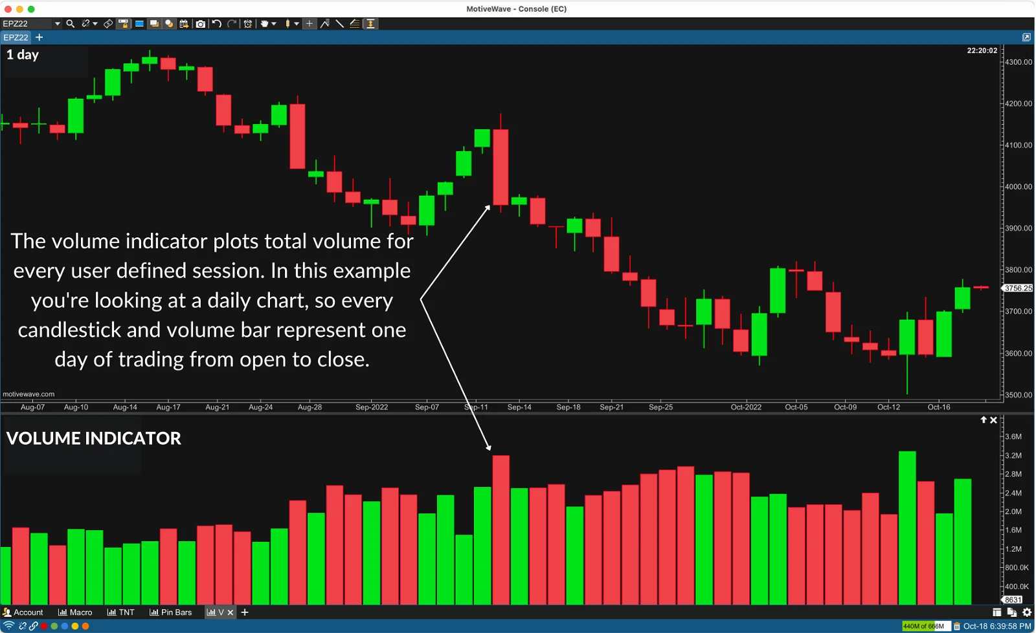
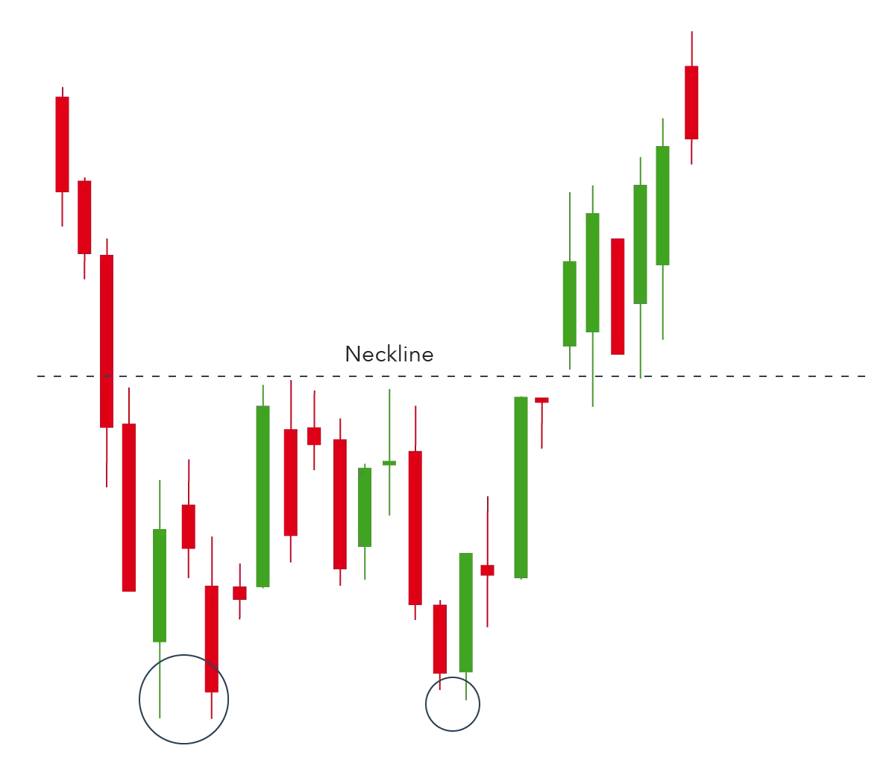
Diversification of Technical Analysis Indicatots
Trend Lines
Momentum Oscillators
Volume Indicators
Chart Patterns
Moving Averages

Slide 8
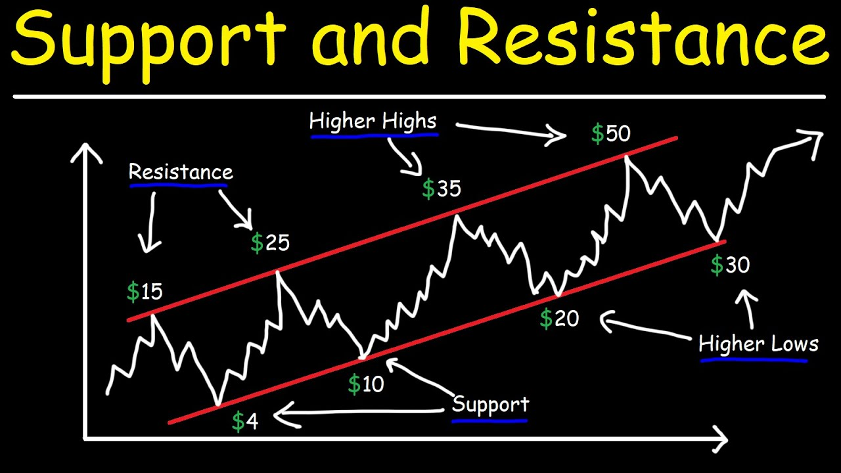




Support and Resistance lines
Support occurs where a downtrend is expected to pause due to a concentration of demand.
Resistance occurs where an uptrend is expected to pause temporarily, due to a concentration of supply.

Slide 9
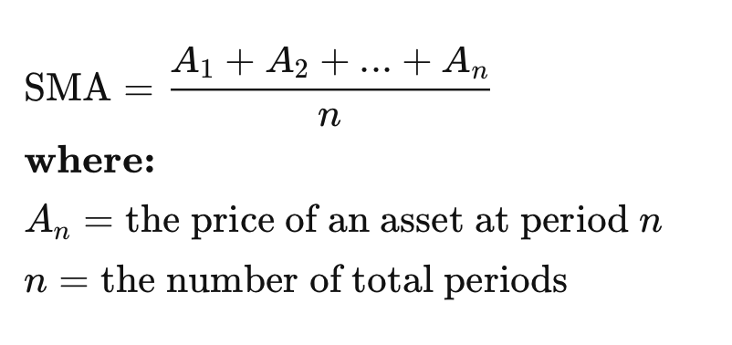
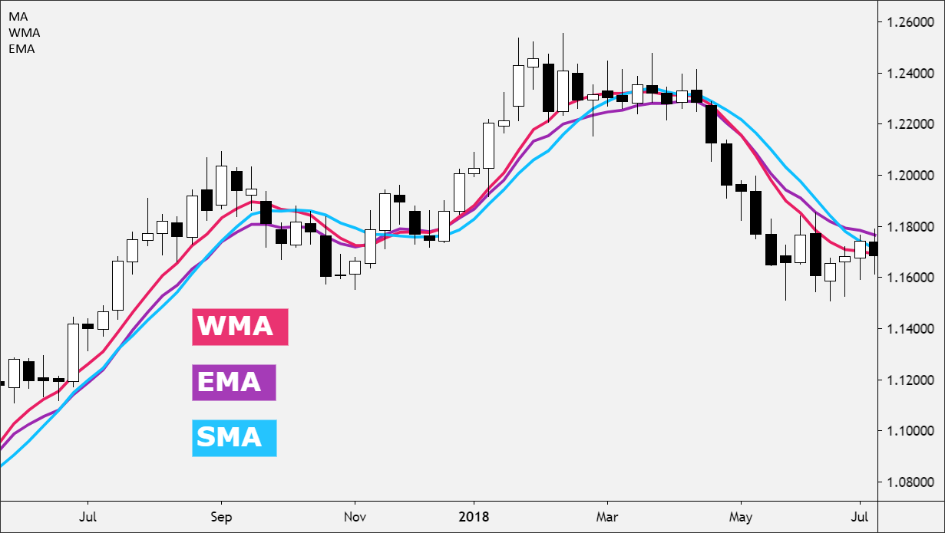
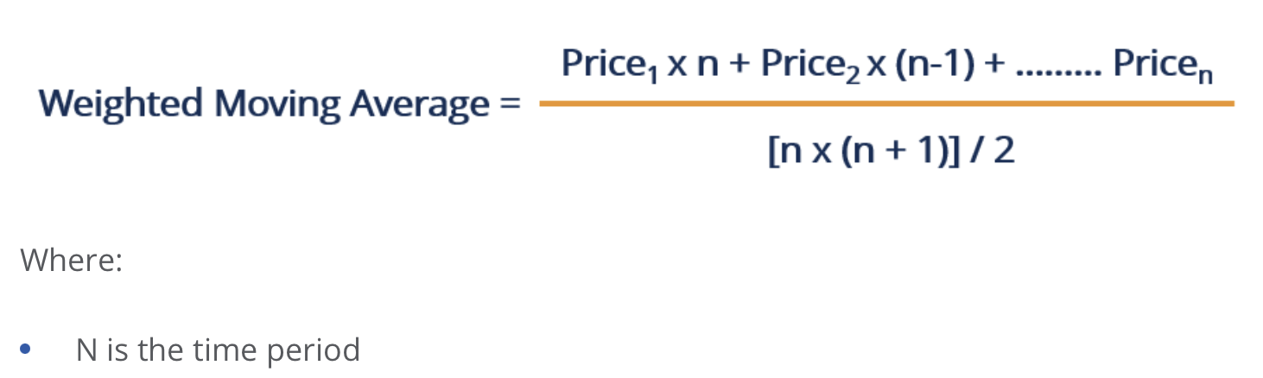
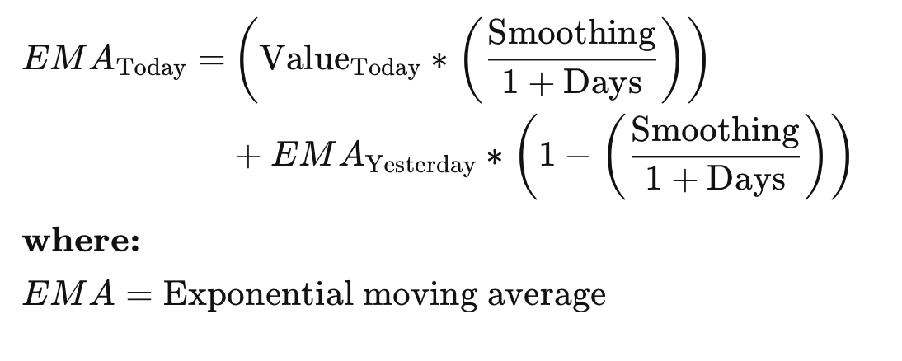
Moving Averages

Slide 10
Research
Data
Limitations
Gold performance at period from 01.10.2018 till 01.05.2020
World Gold Council | https://www.gold.org/
Variables
Aim
A… Actual value at the day n
F… Estimated Price
N… Number of days
To identify best-performing indicator out of 3 given
To detect if the MAPE low enough to be trustworty

Slide 11
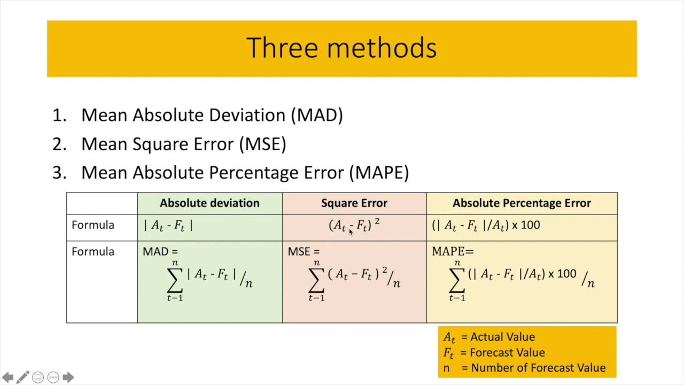
Day | P | F | Error | IErrorI | Error^2 | I%ErrorI
01.10.2018
… |  |  | Total
MAD
MSE
MAPE

Slide 12
Luterature
Murphy, J. J. (1999). Technical Analysis of the Financial Markets. New York, NY: Penguin Random House.
Marshall, B. R., Cahan, R. H., Cahan, J. M. (2008b). Can commodity futures be profitably traded with quantitative timing strategies? Journal of Banking and Finance, 32(9), 1810-1819.
Menkhoff, L. (2010). The use of technical analysis by fund managers: International evidence, Journal of Banking & Finance, 34(11), 2573-2586.
Hiller, D., Draper, P., Faff, R., 2006. So precious metals shine? An investment perspective. Financial Analysts Journal 62, 2, 98--106.
Baur, D.G., and Lucey, B.M. (2010): Is Gold a Hedge or a Safe Haven? An Analysis of Stocks, Bonds and Gold, in: Financial Review, Vol. 45, 217-229.
Urquhart, A., Batten, J., Lucey, B., & McGroarty, F. (Year of publication). Does technical analysis beat the market?
Cervelló-Royo, R., Guijarro, F., Michniuk, K. (2015). Stock market trading rule based on pattern recognition and technical analysis: Forecasting the DJIA index with intraday data. Expert
Systems with Applications, 42(14), 5963-5975. Atanasova, C.V. and Hudson, R.S. (2010). Technical trading rules and calendar anomalies - Are they the same phenomena? Economics Letters, 106(2), 128-130.

Slide 13
Thank you for attention!

